Slide 1
Welcome to
Today`s multimedia class

Slide 2
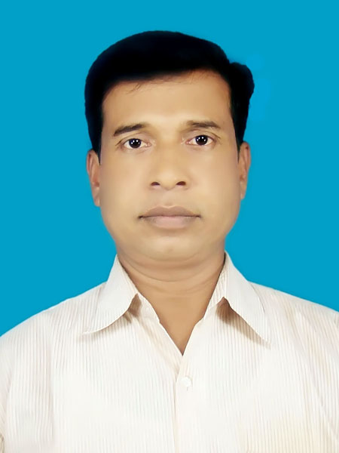
Introductions
Jahedur Rahaman
Assistant Teacher
Sagoria Govt. Primary School
Hatiya,Noakhali
Subject : English
Class: Five
Time-50 minutes
Date:13/02/2018

Slide 3
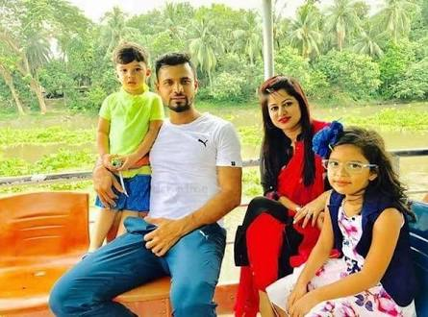
What do you see in the picture and say?
Family

Slide 4
Todays lesson
Saikat’s Family
Saikat Islam lives……… neighbours.

Slide 5
Learning outcomes
The students will be able to-
1. Read the lesson correctly.
2.Similar words and make sentences by using word.
3. Give answer some questions in the text.

Slide 6
Look at the picture and say.
Presentation
Saikat Islam lives with his parents in a flat in Bogra.
His father is a banker.

Slide 7
Look at the picture and say.
Mr. Islam writes
stories in his free time
He listens to
music in his free time.

Slide 8
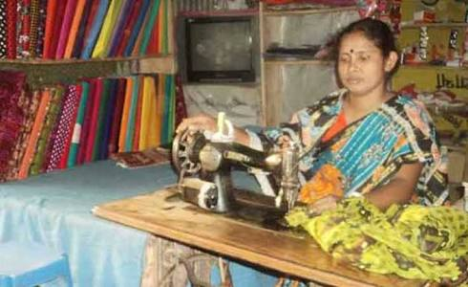
Look at the picture and say.
Saikat’s mother is a
housewife
In her free time she enjoys sewing.
She makes dresses.

Slide 9
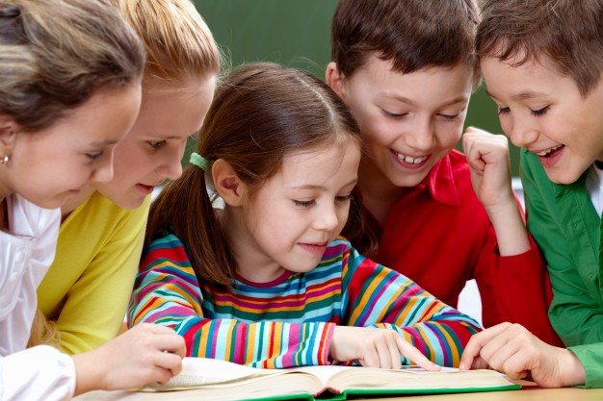
Open your book at page-10

Slide 10
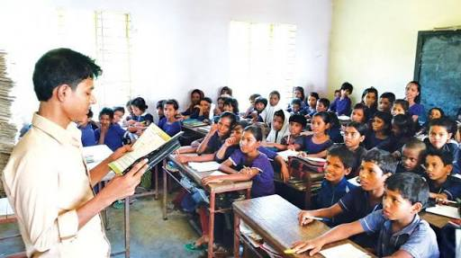
Teacher`s loud reading and discus the lesson.

Slide 11
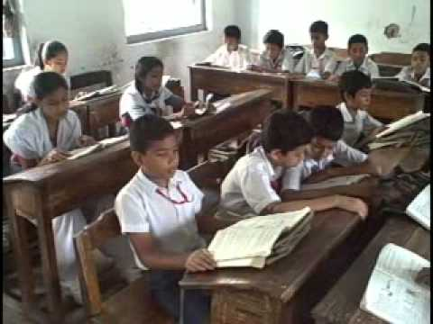
Students silent reading

Slide 12
Answer the following questions.
WCW
1. Who is Saikat ?
Ans: a student.
2. Where does Saikat live?
Ans. Bogra.
3. With whom does he live?
Ans: with parents.

Slide 13
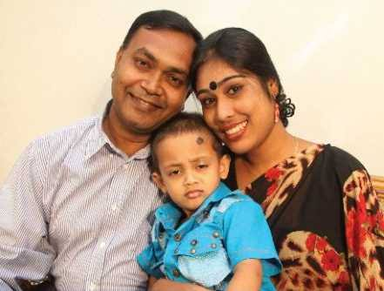
New word , similar word and make sentences
IW
Father and mother
His parents live in Bogra.
parents
Home maker
She is a housewife
Housewife
Listen
hear
He loves listening to song.

Slide 14
Write the answer on the answer paper.
Group work
a) Saikat lives in -------
1.Dhaka. 2.Khulna .3.Chittagong. 4.Bogra.
b) Saikat Islam lives with his--------
1.father,2.sister.3.parents.4.friends.
e) Mrs. Monwara Islam enjoys---
1.To read.2.to watch TV.3.to sew.4.to cook.
c) What is Saikat`s father?
1.A teacher.2.A doctor.3.A singer.4.A banker.
d) Monwara Islam is---
1.a teacher.2.a housewife.3.a nurse.4.a doctor.

Slide 15
Match the words of the column A with their meaning that is mentioned in the text of the column B
Group work
Column A |  | Column B
Parents |  | A woman who looks after her family.
Listen |  | Particularly.
Housewife |  | Father and mother.
Specially |  | A person who works in a bank.
Banker |  | Hear attentively.
 |  | A person who works in a school.

Slide 16
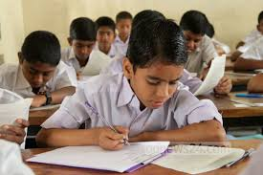
Individual work
Write five sentences about Saikat’s family.

Slide 17
Evaluation
IW
1.What is Saikat`s father`s name?
2.What is Saikat`s mother`s name?
3.What do his parents do in their free time?

Slide 18
Home Work
2. Write five sentences about your family.

Slide 19
Good-bye students
See you tomorrow

